Slide 1
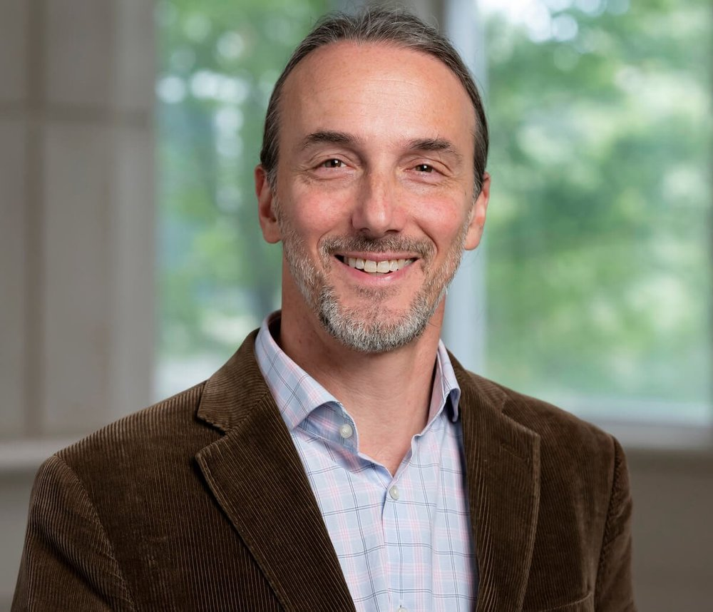

Welcome
2025: A Year in Review
Speaker: Dr. Zach Rosenthal
January 14th, 2026
7:00 - 8:00pm ET

Slide 2
Friendly Reminders
Please keep your microphone and camera off during the presentation portion of this webinar to limit distractions.
Please be mindful of others and avoid actions such as eating, drinking, etc. while your camera and microphone are on during the Q&A portion.
People have different triggers, so try to be as thoughtful as you can.
Please do not promote any materials with a monetary cost.

Slide 3
Thank You
Courageous patients and loved ones who have shared their lived experiences
Friendly scientific colleagues around the world helping to advance knowledge
Curious clinicians open to ways to help people who are suffering
Duke School of Medicine and Department of Psychiatry & Behavioral Sciences
CMER team
The many people and families generously supporting us with small and large donations
The Brown Family (helps to fund CMER Outreach and Education efforts)

Slide 4
Supporting Duke CMER
We are dedicated to understanding the causes and developing treatments for misophonia
You can support this work in many ways:
Clinicians can email us at psychcmer@dm.duke.edu to learn more about ways to learn about treatment approaches for Misophonia
Researchers can contact us about collaborations via email
Educators and advocates can contact us via email to collaborate together on shared visions
We exist due to families donating $ to support everything we do. If interested in supporting us in this way, go to: https://www.gifts.duke.edu/dmaa and type in “Misophonia." Your $ will support our research, awareness, and advocacy efforts.
Anyone wishing to give can contact Dr. Rosenthal to learn about how their funds will support the mission

Slide 5

https://www.misophoniaresearchfund.org
Thank You Misophonia Research Fund

Slide 6
10 Big Advancements in 2025

Slide 7

Record Breaking Registrations for 3rd Annual CARE for Misophonia Day
10.
Conversations About Research for Everyone (CARE) Day is hosted by Duke CMER, soQuiet, and the Misophonia Research Network (MRN).
This year, we had over 1,100 registrants – the most we've ever had!
CARE Day was established for anyone, with or without a research background, to understand the current state of misophonia research.
Thank you to the dedicated researchers who presented!

Slide 8
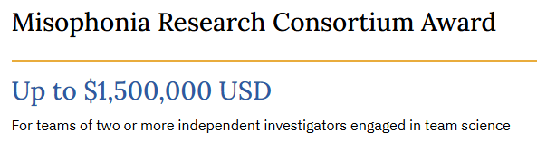

Paving the Way for Future Research
9.
The Misophonia Research Fund (MRF) introduced a new funding opportunity this year, the Misophonia Research Consortium Award. This mechanism encourages investigators to work together on misophonia-related research projects.
The first Prospective Researchers Investigating Misophonia and Emotion Regulation (PRIMER) Summer Workshop for High School Students was hosted in July of 2025. High school students from around the United States and a student from the United Arab Emirates joined attended via Zoom for a 3-day workshop to gain foundational knowledge of the science of misophonia, conduct of human research, and project development. Their dedication to learning more about misophonia and research development provided a hopeful look into the future of misophonia research.

Slide 9
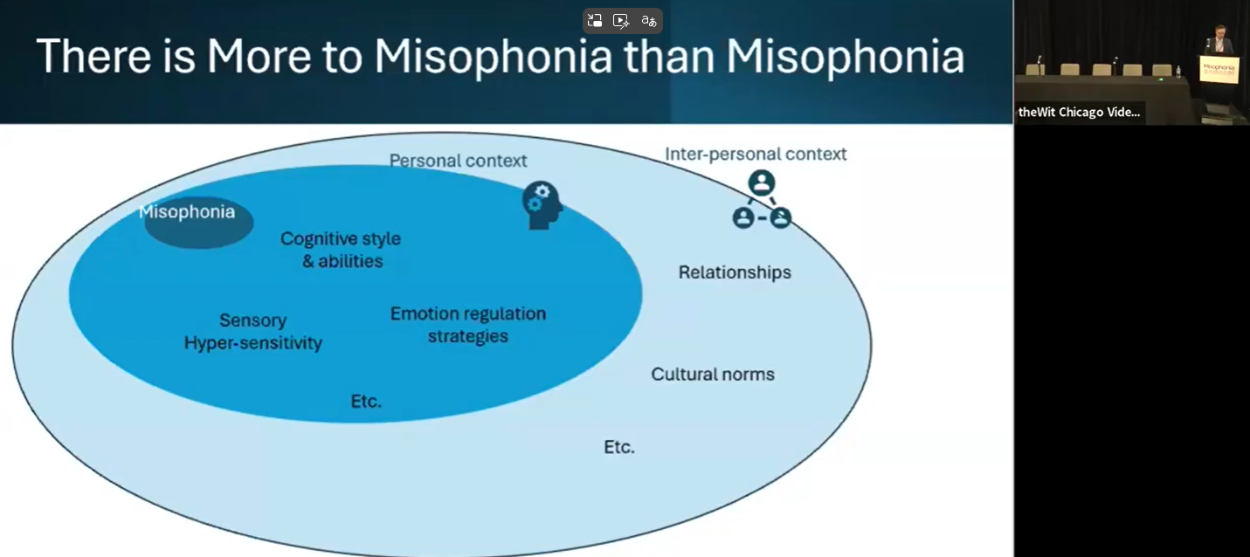
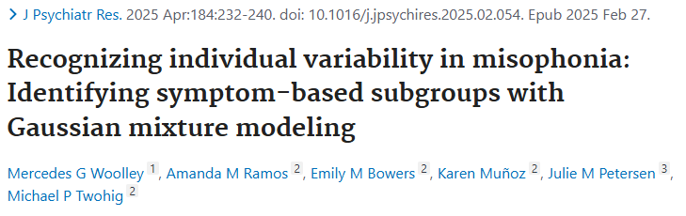
Better Understanding of Variability and Role of Context
8.
At the Misophonia Collaboration Forum, Dr. Jamie Ward started the day off speaking about our current understanding of misophonia. Part of his presentation included the model pictured to the left. Dr. Ward highlighted the many factors that contribute to an individual's experience of misophonia.
Woolley et al., 2025 found symptoms to vary among misophonia participants and suggest individualized interventions for misophonia patients.
At Duke CMER, we speak to people with misophonia everyday through our clinical, research, outreach, and education efforts. We have seen variability in symptoms and experiences of those with misophonia.

Slide 10
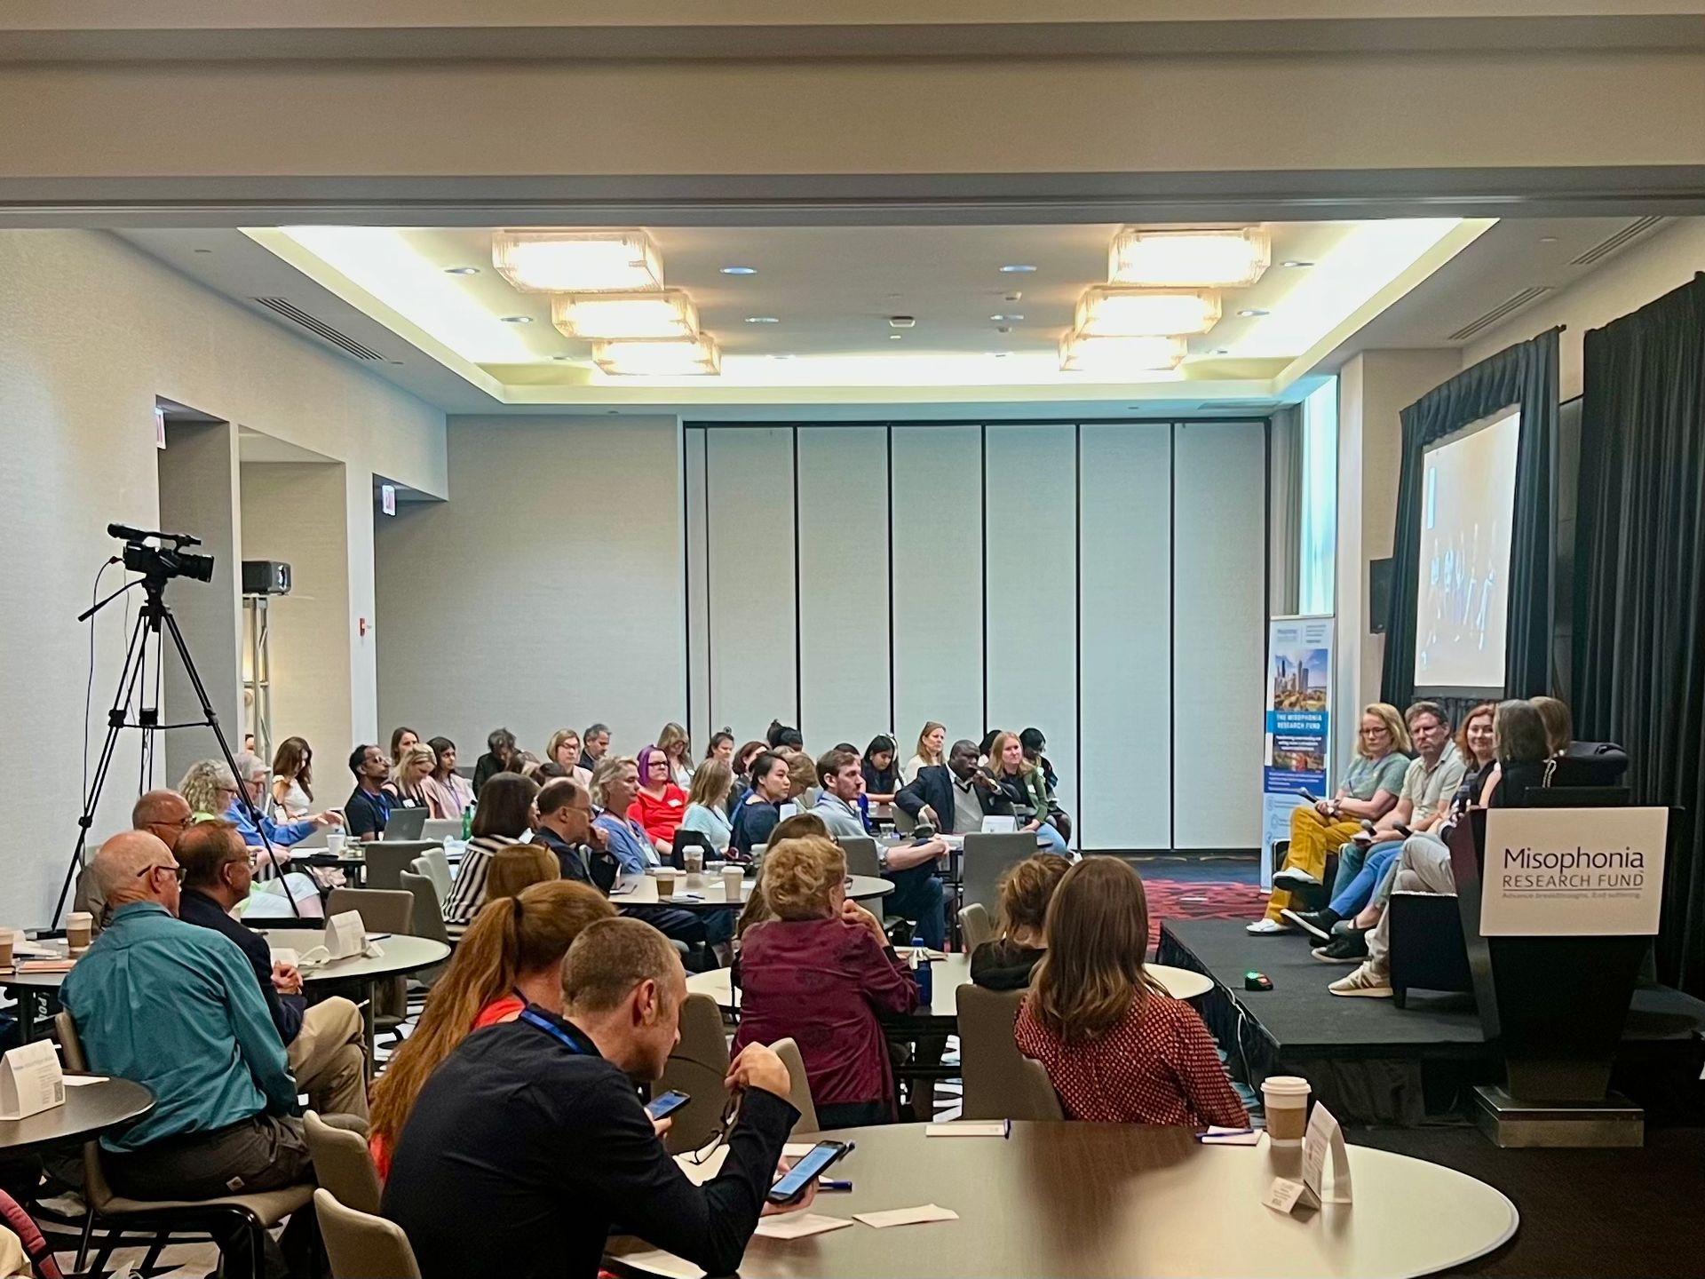
1st Misophonia Collaboration Forum
7.
In September, the Misophonia Research Fund (MRF) hosted the first Misophonia Collaboration Forum in partnership with Duke CMER, soQuiet, the Misophonia Research Network (MRN), and Northwestern's Knowles Hearing Center.
The event included presentations, panels, and breakout groups with clinicians, researchers, and members of the lived experience community from all around the world. We were grateful to be part of such an impactful and meaningful day for the misophonia community.

Slide 11
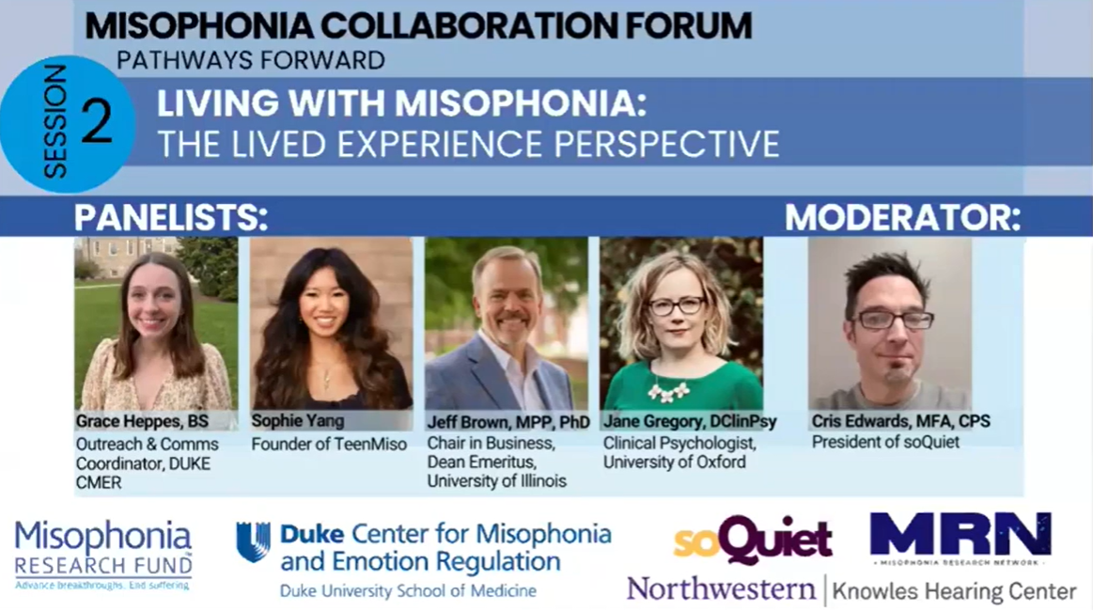
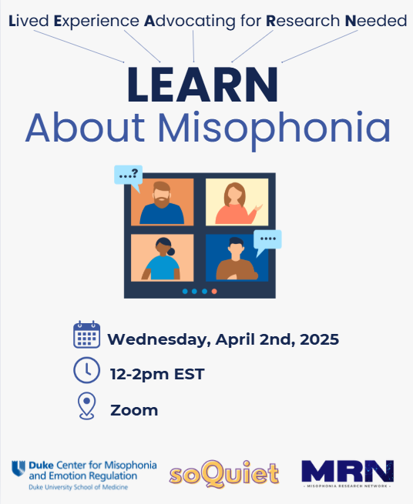
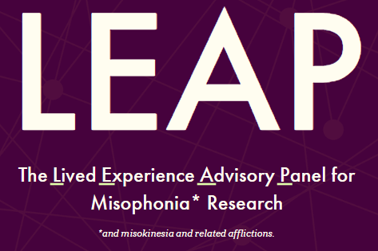
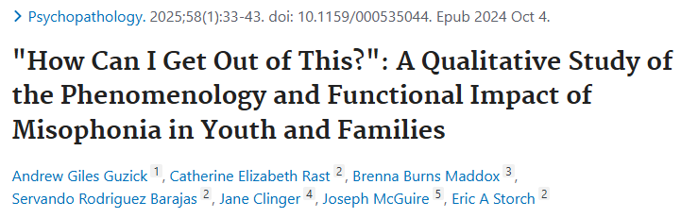
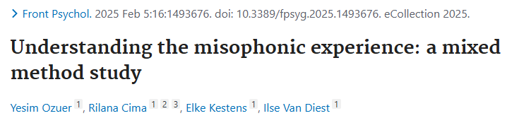
Amplifying Lived Experience Voices
6.
We are grateful to be part of a community that values lived experience voices. More research studies are focusing on perspectives of those with misophonia in their work and seeking lived experience input on their interpretation of the results with soQuiet's Lived Experience Advisory Panel (LEAP).
The first Lived Experience Advocating for Research Needed (LEARN) About Misophonia webinar allowed people with misophonia and their loved ones to share their priorities for research and clinical care.
At the first Misophonia Collaboration Forum, there was a panel dedicated to the lived experience perspective. This panel allowed lived experience voices to be heard by clinicians and researchers in the field and for others with lived experience to feel seen.

Slide 12
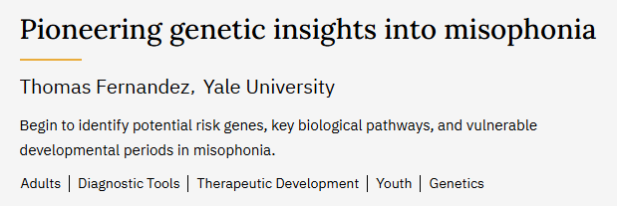
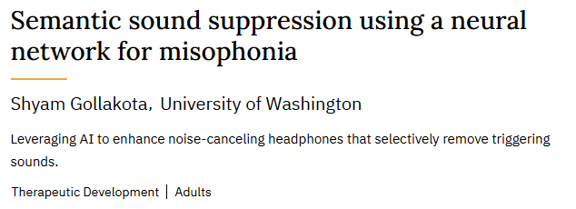
Efforts Expanding Across Disciplines
5.
The Misophonia Research Fund (MRF) funded a study to determine if there are genetic factors affecting misophonia development. Areas of focus include potential risk genes, biological pathways, and vulnerable developmental periods. Dr. Thomas Fernandez and his team at Yale University started conducting this work in 2025.
In the MRF 2025 grant cycle, Dr. Shyam Gollakota was one of the eight recipients of the Research Impact Award. Dr. Gollakota and his team at University of Washington are developing a sound suppression system to integrate into noise-cancelling headphones, allowing trigger sounds to be reduced in real time. The Duke CMER team will assist with study design, recruitment, data collection, manuscript preparation, and dissemination of results. In addition, we will provide support and guidance about protection of human participants and emotional distress throughout the study duration.

Slide 13
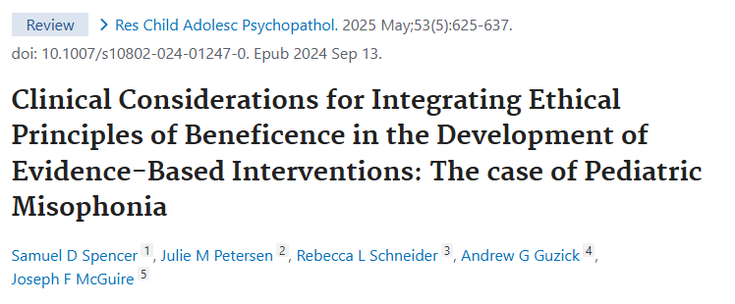
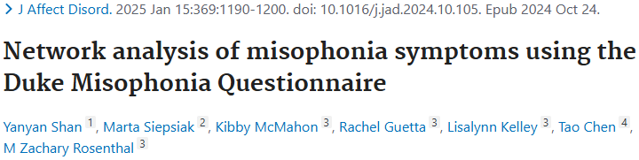
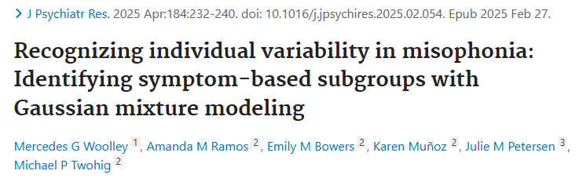
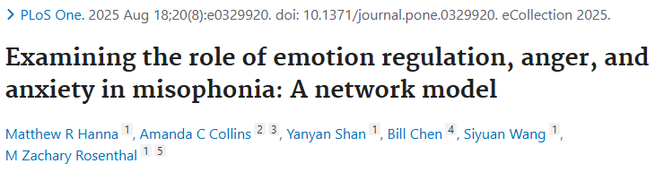
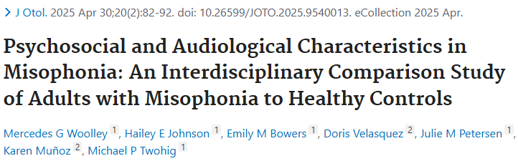
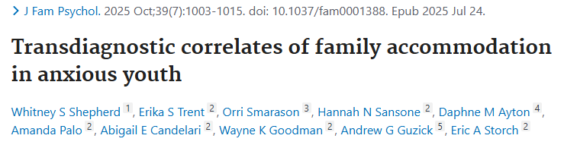
New Insights for Treatment Targets
4.
Spencer et al., 2025 emphasized important considerations for treatment development: (1) considering cognitive and behavioral mechanisms, (2) using CBT frameworks that are tailored to misophonia, not OCD, and (3) including lived experience community members.
Shan et al., 2025 showed the DMQ Impairment subscale to be most central in the network for both males and females, although females reported more severe cognitive and physiological symptoms. This study suggests it may be helpful to prioritize these symptoms during assessment and intervention.
Woolley et al., 2025 highlighted the variability of misophonia's presentation in individuals. Results of this study show the importance of individualizing interventions for misophonia patients.
Hanna et al., 2025 emphasized the role of nonacceptance, emotional awareness, anger, and anxiety in misophonia severity. These findings suggest interventions targeting nonacceptance, anger, and anxiety may be helpful for those with misophonia.
Woolley et al., 2025 found that individuals with misophonia experience higher levels of psychological inflexibility, stress, and difficulty with auditory processing. These results support the need for interdisciplinary interventions.
Shepherd et al., 2025 found the association between anxiety symptom severity and family accommodation to be stronger when a child's distress tolerance was lower. Results suggest interventions targeting distress tolerance skills and family accommodation could be beneficial for children with misophonia and their families.

Slide 14
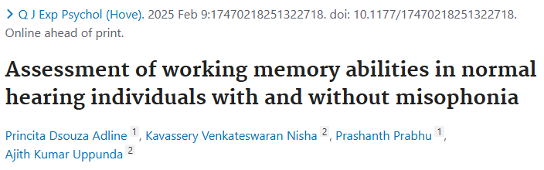
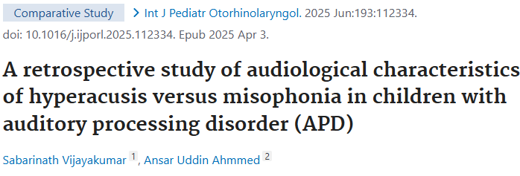
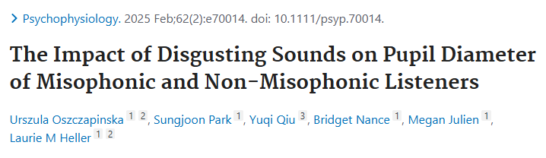
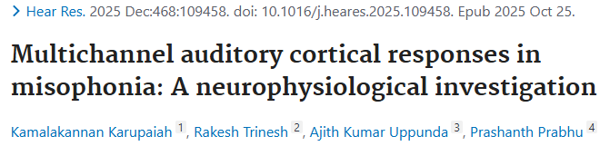
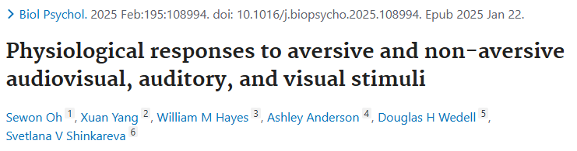
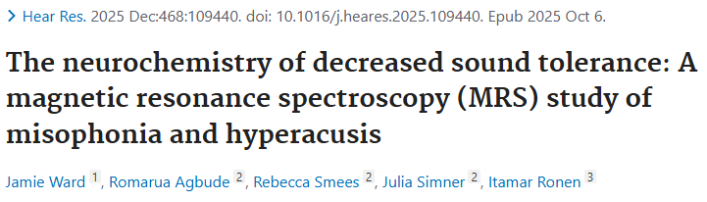
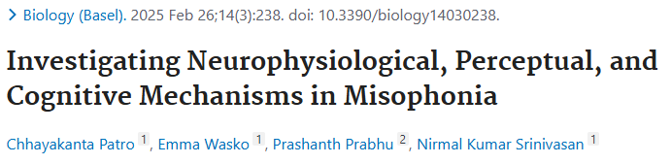
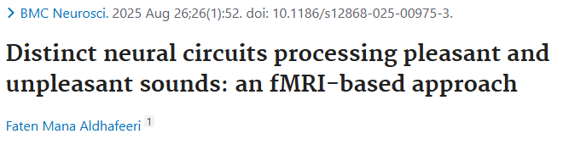
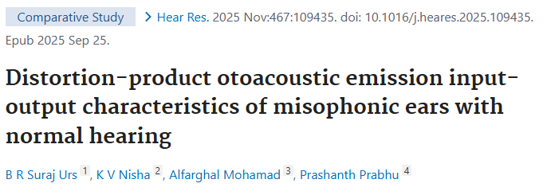
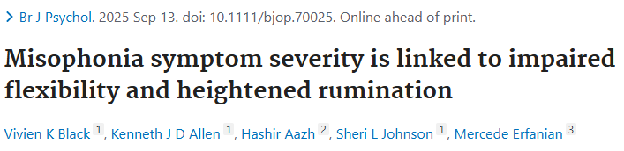
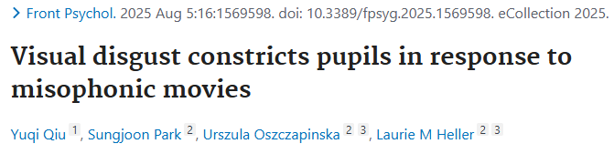
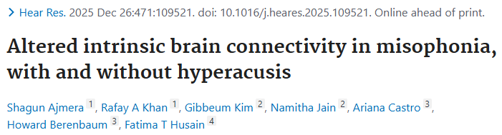
Advancing Understanding of Biological Characteristics
3.
This year was full of studies examining the biological characteristics of misophonia. If you have specific questions about these studies, please email us, psychcmer@dm.duke.edu.

Slide 15
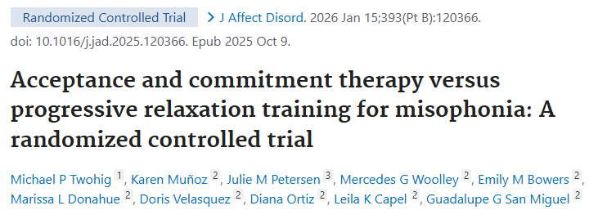
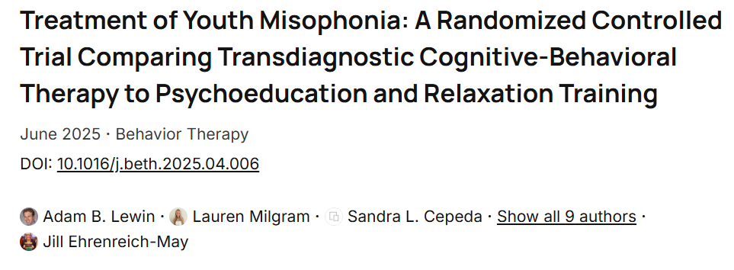
Randomized Controlled Trials
2.
Dr. Michael Twohig's team at Utah State University conducted a randomized controlled trial to test the effectiveness of acceptance and commitment therapy (ACT) in comparison to progressive relaxation training (PRT) for misophonia. Both treatments were found to be credible and acceptable by the participants. The results of this trial suggest that psychosocial interventions may be beneficial for adults with misophonia, although further research is needed.
Dr. Adam Lewin at University of South Florida led the first randomized controlled trial involving youth assessing the therapeutic benefit of the Unified Protocol for Children and Adolescents (UP-C/A) versus PRT. UP-C/A benefited youth about twice as more as PRT, but both were found to be acceptable and decreased daily impairment.

Slide 16

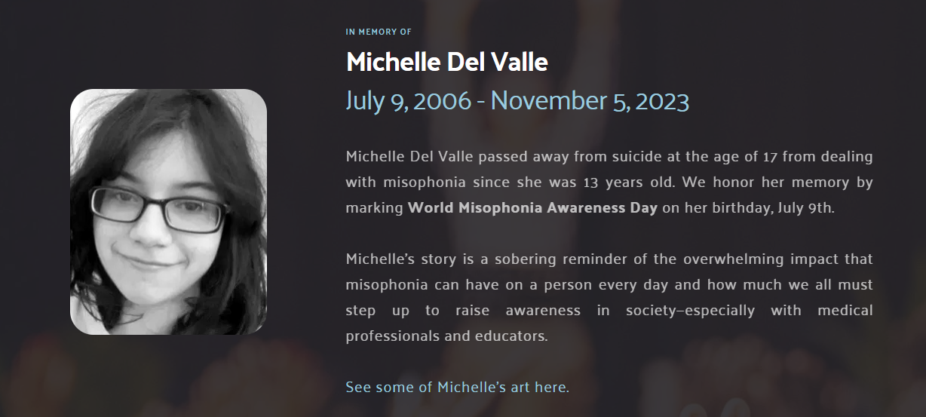
1st World Misophonia Awareness Day
1.
soQuiet led the initiative to establish July 9th as World Misophonia Awareness Day in memory of Michelle Del Valle.
Organizations from around the world teamed up to raise awareness of misophonia and push for clinical recognition.

Slide 17
So...what's next in 2026?

Slide 18
CMER's Next Steps: Advocacy/Awareness
With generous support from the Brown Family, we are able to dedicate time and resources towards a future where doctors and other clinicians provide evidence-based resources and clinical services for people with misophonia.
In 2026, we will:
Develop a continuing medical education (CME) course for physicians and continue to offer education and resources to every family physician and pediatrician related organization in the United States
Attend conferences and host webinars to educate multi-disciplinary clinicians
Host quarterly webinars, the 2nd annual LEARN About Misophonia webinar, and the 2nd annual PRIMER Summer Workshop for High School Students
Validate families impacted by misophonia and provide them with evidence-based resources and guidance
Co-host the 4th annual CARE Day to ensure everyone understands the current state of misophonia research

Slide 19
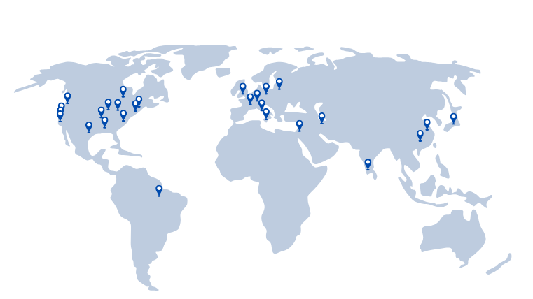
CMER's Next Steps: Research
We will continue to address the following topics in our research:
Italian and Mandarin adaptations of the Duke Misophonia Questionnaire (DMQ)
Proposing a model of misophonia focusing on sensory processing and emotion regulation
Variability of the lived experience among adults
Understanding perspectives from occupational therapists about misophonia
Neuroimaging of misophonia patients
Neurostimulation as possible new treatment
Prevalence and awareness of misophonia in the United States
Exploring the nature and features of misophonia in China
Proof of concept study for an AI-based platform to suppress trigger sounds
Development of Process-Based Therapy for Misophonia
As well as continuing collaborations around the world

Slide 20
CMER's Next Steps: Clinical
If you're interested in supporting our efforts to bring on a child psychologist, please visit https://psychiatry.duke.edu/duke-center-misophonia-and-emotion-regulation/about-us/support-us

Slide 21
What will "2026: Year in Review" look like?
Here's some of what we hope happens this year:
Misophonia approved as a diagnosis in the ICD-11
New treatment studies published
More lived experience studies published
Larger and more rigorous studies exploring biological factors
Improved clinical care for misophonia
Greater awareness and advocacy for people around the world with misophonia

Slide 22




Connect with us
@dukecenterformisophonia
@dukecmer
@duke-cmer
@dukecmer
psychcmer@dm.duke.edu
www.misophonia.duke.edu

Slide 23
Thank You!
Please feel free to contact us: psychcmer@dm.duke.edu

